Slide 1
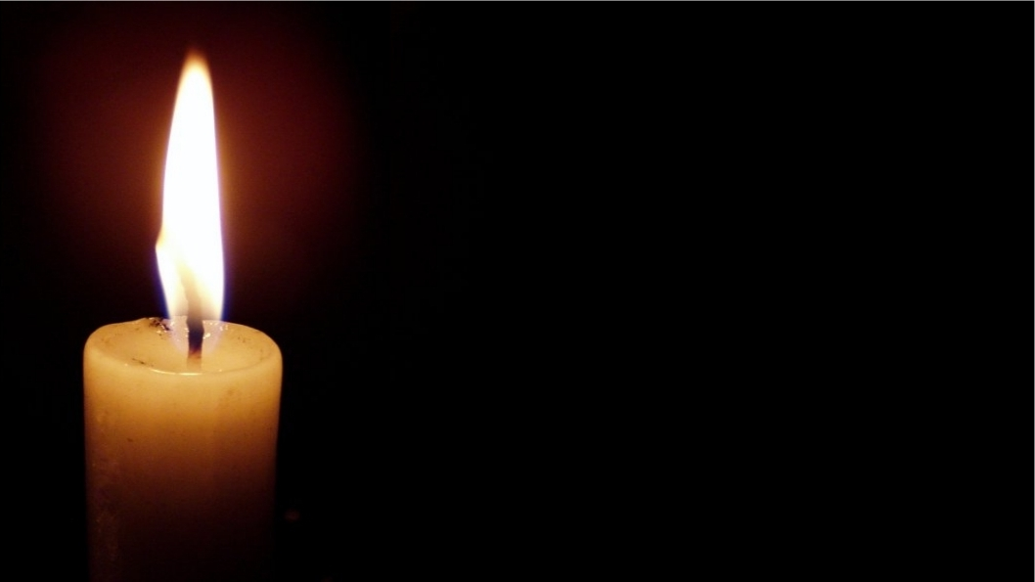
Hymn #367
“Angels from the Realms of Glory”

Slide 2
1. Angels from the realms of glory,
Wing your flight o’er all the earth;
Ye who sang creation’s story,
Now proclaim Messiah’s birth.

Slide 3
Refrain:
Come and worship,
come and worship;
Worship Christ,
the newborn King.

Slide 4
2. Shepherds in the field abiding,
Watching o’er your flocks by night,
God with us is now residing,
Yonder shines the Infant Light.

Slide 5
Refrain:
Come and worship,
come and worship;
Worship Christ,
the newborn King.

Slide 6
3. Sages, leave your contemplations,
Brighter visions beam afar;
Seek the great Desire of nations,
Ye have seen His natal star.

Slide 7
Refrain:
Come and worship,
come and worship;
Worship Christ,
the newborn King.

Slide 8
4. Saints before the altar bending,
Watching long in hope and fear,
Suddenly the Lord, descending,
In His temple shall appear.

Slide 9
Refrain:
Come and worship,
come and worship;
Worship Christ,
the newborn King.

Slide 10
5. All creation, join in praising
God the Father, Spirit, Son,
Evermore your voices raising
To the_eternal Three in One.

Slide 11
Refrain:
Come and worship,
come and worship;
Worship Christ,
the newborn King.
Public Domain

